Slide 1
Week 4 : Generics
WIA1002/ WIB1002/WXES1117 :
Data structure

Slide 2
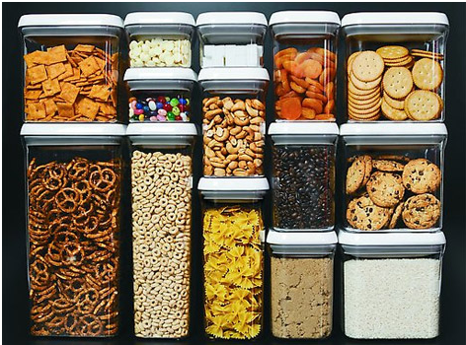

Slide 3
What is Generics?
Generics is the capability to parameterize types. With this capability, you can define a class or a method with generic types that can be substituted using concrete types by the compiler.
For example, you may define a generic stack class that stores the elements of a generic type. From this generic class, you may create a stack object for holding strings and a stack object for holding numbers. Here, strings and numbers are concrete types that replace the generic type.

Slide 4
Why Generics?
The key benefit of generics is to enable errors to be detected at compile time rather than at runtime. A generic class or method permits you to specify allowable types of objects that the class or method may work with. If you attempt to use the class or method with an incompatible object, a compile error occurs.

Slide 5
Generic Type
Formal generic type
Generic Instantiation
Compiles ok, but Runtime error
Advantage : Improves reliability
Compile error

Slide 6
Generic ArrayList in JDK 1.5

Slide 7
Generic types
ArrayList<String> list = new ArrayList<String>();
list.add(“Red”); //ok
list.add(new Integer(1));
E must be reference types(e.g. Integer, Double, MyPet), cannot be a primitive type (e.g. int, double, char etc.)

Slide 8
No Casting Needed
Because compiler knows the element type.
ArrayList<Double> list = new ArrayList<Double>();
list.add(5.5); // 5.5 is automatically converted to new Double(5.5)
list.add(3.0); // 3.0 is automatically converted to new Double(3.0)
Double doubleObject = list.get(0); // No casting is needed, but
// before JDK 1.5, need casting
double d = list.get(1); // Automatically converted to double

Slide 9
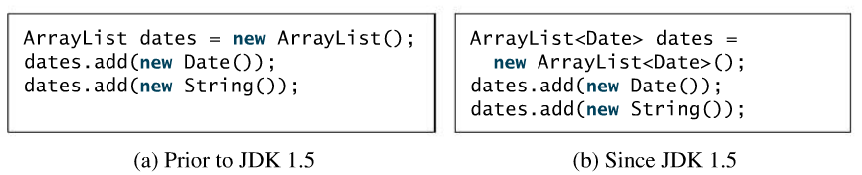
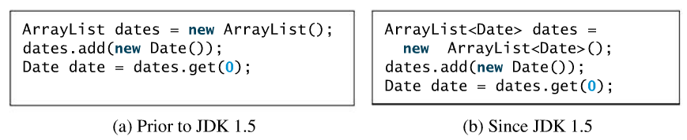
Check Point 1
What is the benefit of using generic types?
Are there any compile errors in (a) and (b)?
What is wrong in (a)? Is code in (b) correct?

Slide 10
Generic types
Generics can be defined for a :
Class
Interface
Method

Slide 11
Declaring Generic Classes
Syntax :
public class ClassName<E> { }
e.g.
public class Cat<E> { }
public class Insurance<E> { }

Slide 12
Declaring Generic Interface
Syntax :
public interface IntefaceName<E> { }
e.g.
public interface Comparable<E> { }
public interface Edible<E> { }

Slide 13
Declaring Generic Classes and Interfaces
GenericStack

Slide 14
GenericStack<String> stack1 = new GenericStack<String>();
stack1.push(“London”);
stack1.push(“Paris”);
stack1.push(“Berlin”);
GenericStack<Integer> stack2 = new GenericStack<Integer>();
stack2.push(1); //autoboxing 1 to new Integer(1)
stack2.push(2);
stack2.push(3);
GenericStack<Object> stack2 = new GenericStack<Object>();

Slide 15
Info abt Generics
Generics class constructor is defined as
e.g. public GenericStack();
2. Generics class may have more than 1 parameter.
e.g. <E1, E2, E3>
3. You can define a class/interface as a subtype of a generic class/interface.
e.g. public class String implements Comparable<String>

Slide 16
Check Point 2
Declare generic class for GenericList?
Declare generic interface for List?
What are generic classes and interfaces?
Can a generic class have multiple generic parameters?
An instance of ArrayList of strings using new ArrayList<String>() is created. How should the constructor be defined as?

Slide 17
Generic Methods
Syntax :
public static <E> returnType methodName(E parameter)
Example :
public static <E> void print(E[] list)
public <E> boolean isFilled(E filled)
To declare generics – place <E> before returnType
To invoke/call method – place <actualType>methodName
or as usual method call
GenericMethod

Slide 18
Generic Methods
public static <E> void print(E[] list) {
for (int i = 0; i < list.length; i++)
System.out.print(list[i] + " ");
System.out.println();
}
public static void print(Object[] list) {
for (int i = 0; i < list.length; i++)
System.out.print(list[i] + " ");
System.out.println();
}

Slide 19
Bounded Generic Type
Bounded = A generic type specified as a subtype of another type
E.g. : <E extends GeometricObject>
E is a generic type of GeometricObject
BoundedGeneric
Run

Slide 20
Check Point 3
Declare a static generic method for myMethod that does not return anything, but accepts one parameter called a?
myMethod is contained in class called MyClass. Assume an ArrayList of type Double called d has been created in the MyClass. Invoke a generic method for myMethod.
What is bounded generic type?

Slide 21
Raw Type and Backward Compatibility
Raw type : Generic class used without type parameter
// raw type
ArrayList list = new ArrayList();
This is roughly equivalent to
ArrayList<Object> list = new ArrayList<Object>();

Slide 22
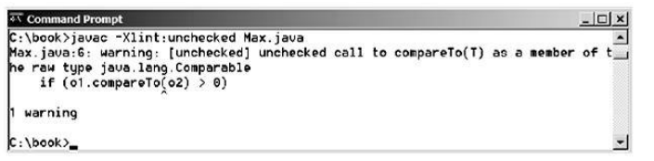
Raw Type is Unsafe
// Max.java: Find a maximum object
public class Max {
/** Return the maximum between two objects */
public static Comparable max(Comparable o1, Comparable o2) {
if (o1.compareTo(o2) > 0)
return o1;
else
return o2;
}
}
Runtime Error:
Max.max("Welcome", 23);
Max
Run

Slide 23
Make it Safe
// Max.java: Find a maximum object
public class Max {
/** Return the maximum between two objects */
public static <E extends Comparable<E>> E max(E o1, E o2) {
if (o1.compareTo(o2) > 0)
return o1;
else
return o2;
}
}
Max.max("Welcome", 23);

Slide 24
Wildcards
Why wildcards are necessary? See this example.
WildCardNeedDemo
* intStack is not an instance of GenericStack<Number>
? unbounded wildcard (represents any object type)
? extends T bounded wildcard (unknown subtype of T)
? super T lower bound wildcard (unknown supertype of T)
AnyWildCardDemo
SuperWildCardDemo
<?> equals <? extends Object>
intStack is not an instance of
GenericStack<Object>

Slide 25
Generic Types and Wildcard Types

Slide 26
Avoiding Unsafe Raw Types
Use
new ArrayList<ConcreteType>();
Instead of
new ArrayList();
TestArrayListNew
Run

Slide 27
Check Point 4
Is GenericStack the same as GenericStack<Object>?
What are unbounded wildcard, a bounded wildcard, and a lower bounded wildcard?
In example SuperWildCardDemo.java, what happens if line 12-13 are changed to
public static <T> void add<GenericStack<T> stack1, GenericStack<T> stack2)

Slide 28
Erasure and Restrictions on Generics
Generics are implemented using an approach called type erasure. The compiler uses the generic type information to compile the code, but erases it afterwards. So the generic information is not available at run time. This approach enables the generic code to be backward-compatible with the legacy code that uses raw types.

Slide 29
Compile Time Checking
For example, the compiler checks whether generics is used correctly for the following code in (a) and translates it into the equivalent code in (b) for runtime use. The code in (b) uses the raw type.

Slide 30
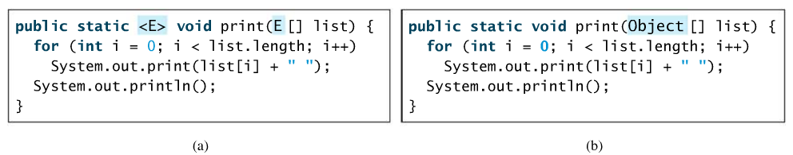
Compile time checking
When generic classes, interfaces and methods are compiled, the compiler replaces the generic type with the Object type.

Slide 31
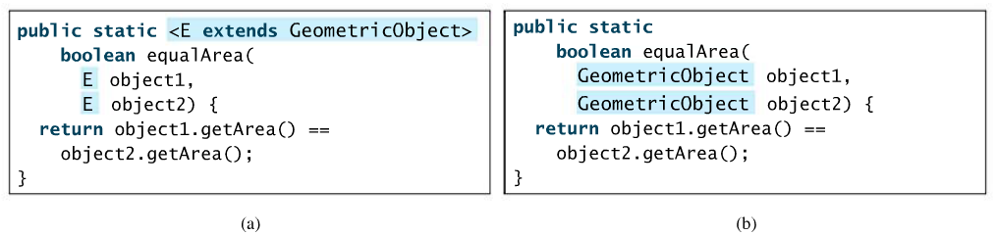
Compile time checking
If a generic type is bounded, the compiler replaces it with the bounded type.

Slide 32
Important Facts
It is important to note that a generic class is shared by all its instances regardless of its actual generic type.
GenericStack<String> stack1 = new GenericStack<String>();
GenericStack<Integer> stack2 = new GenericStack<Integer>();
System.out.println(stack1 instanceof GenericStack); //true
System.out.println(stack2 instanceof GenericStack); //true
Although GenericStack<String> and GenericStack<Integer> are two types, but there is only one class GenericStack loaded into the JVM.

Slide 33
Restrictions on Generics
Restriction 1: Cannot Create an Instance of a Generic Type. (i.e., new E()).
2. Restriction 2: Generic Array Creation is Not Allowed. (i.e., new E[100]).
3. Restriction 3: A Generic Type Parameter of a Class Is Not Allowed in a Static Context.
4. Restriction 4: Exception Classes Cannot be Generic.

Slide 34
Restriction 1 : Cannot use new E()
E object = new E();
new E() is executed at runtime, but E not available

Slide 35
Restriction 2 : Cannot use new E[]
E[] elements = new E[capacity]
Avoid error by having :
E[] elements = (E[]) new Object[capacity]
But causes unchecked compile warning because compiler isn’t smart enough!
e.g : E is String, new Object[] is Integer
((String[]) new Object[]) //compile error

Slide 36
Restriction 3 : Generic type not allowed in Static Context
public class Test<E> {
public static void m(E o1) { //Illegal static method
//some codes
}
public static E o1; //Illegal field
static {
E o2; //Illegal
}
}

Slide 37
Restriction 4: Exception classes cannot be Generic
Generic class may not extend java.lang.Throwable. So, the following is illegal
public class MyException<T> extends Exception { }
Because the type information is not present at runtime
try {
...
}
catch(MyException<T> ex) {
...
}

Slide 38
Check Point 5
If a program uses ArrayList<String> and ArrayList<Date>, does the JVM load both of them?
What is the problem with this code :
E object = new E();
3. Can you define a generic exception class? Why?

